Slide 1
MIT COVID-19 Datathon
Track C: Disparities in COVID-19 Health Outcomes
Team 006
By: Muhammad Jarir Kanji, Ellie Dehoney, Ian Yen, Tashi Gurung, Shreyansh Badia, Mikiko Bazeley

Slide 2
Research Question: Are there disparities in different racial and ethnic groups’ ability to observe social distancing?
Hypothesis: Racial and ethnic groups differ in social distancing capabilities.
Where it’s understood that a difference in capability of observing social distancing leads to different levels of infection.
Notes:
There is a distinction between the ability to socially distance and the performance of social distancing (i.e., doing it in practice), with individual behaviours causing the difference between them. But, I'd think, examining that nuance would be difficult to do within the time frame we have.
There are also different data points that are more relevant to each of these things. For example, the Google Mobility data relates more to actual performance of social distancing, whereas the number of people employed in health care (essential workers) or the median income in a county would relate more to the ability to socially distance, because poorer people or essential workers simply do not have the ability to not go to work.
So, in my mind, whether our own work has that assumption would depend largely on which factors we use. If we don't use mobility data, for example, and focus on demographic factors alne, then we're not really looking at who is and isn't performing social distancing. Thus, the assumption would not necessarily be inherent within our model. Alternatively, even if we do use mobility data, it is a fair assumption that those who don't socially distance are likely to be unable to do so, and we can leave that as something that future research should focus on. Ultimately, as Mikiko mentioned on the call, we can't exactly pull off an entirely academically rigorous study which addresses and proves literally every assumption we make in less than a week.

Slide 3
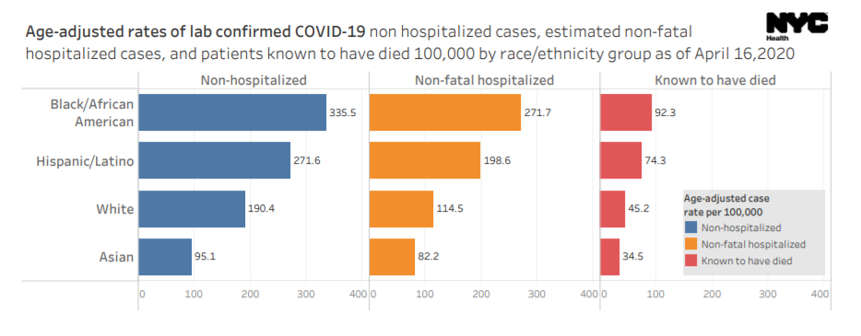
Disparities in Health Outcomes
Source: NYC Health

Slide 4
Understanding Why - the Logic
Racial disparities affect the ability/ performance of social distancing
Differences in the ability/ performance of social distancing = different risks for COVID-19 infection
Disparities in health outcomes among racial groups
(COVID morbidity/mortality)
Data analysis
Literature review
The rate of doubling of cases has reduced sharply from 3.31 days to 100 days
In the state of Minnesota, the number of predicted COVID-19 deaths over a period of twelve months has reduced from 57,000 to 29,000.

Slide 5
Lack of Social Distancing in Different Racial and Ethnic Groups
The legal segregation in schools and housing, discrimination in the labor market and redlining, the practice of denying home loans to those living in predominantly African-American neighborhoods have contributed to a persistent racial wealth gap, with African-Americans continuing to struggle to move into neighborhoods with the sorts of socioeconomic opportunities that allow white families to better avoid exposure to COVID-19.
Upto 75% of the frontline workers in New York are people of color
According to the Bureau of Labor Statistics, only 19.7% of black workers and 16.2% of latinx workers are able to telework

Slide 6
Methodology
SDI
Variance in SDI
A means of quantifying social distancing
Use multivariate regression to understand the importance of different demographic factors with regard to one’s ability to socially distance.

Slide 7
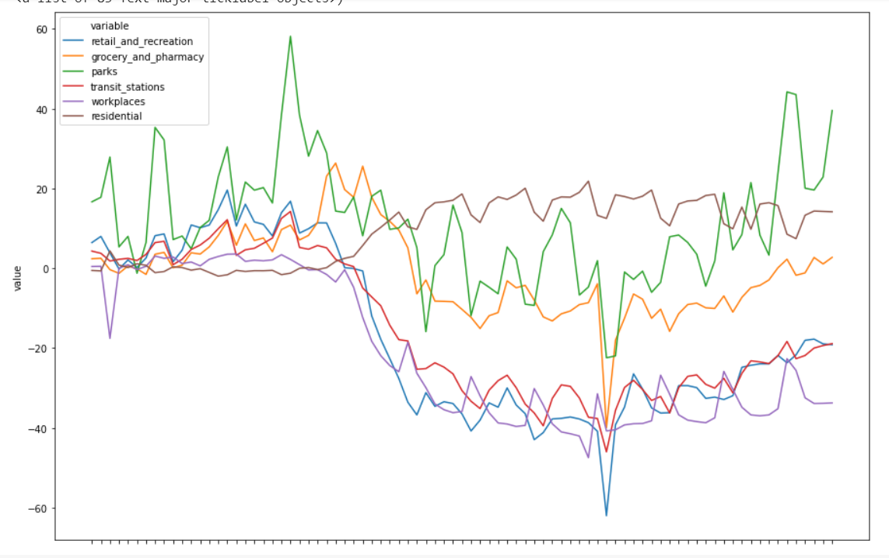
Datasets We’re Using
Google Community Mobility Data
County-level changes to different types of mobility.
Work, residential, retail, grocery
A proxy for social distancing.
A means for us to calculate a social distancing index
American Community Survey
Detailed county-level demographic, economic, and other data.

Slide 8
Data Processing
1.Change in average distance traveled
3.Encounter Density
1. Homes: Overcrowded housing
2.Neighborhoods: Population density
2.Change in visitation to non-essential venues
3.Workplaces: Essential jobs
Unacast SD Index
Colorado SD Index
Master table by county
Calculate social distancing index
Analysis of social distancing index by racial population
Notes:
Features (3 from google mobility; 3 from ACS)
Adopted Unicast methodology (% change on the corresponding days and averaged them out) but mined the google mobility data

Slide 9
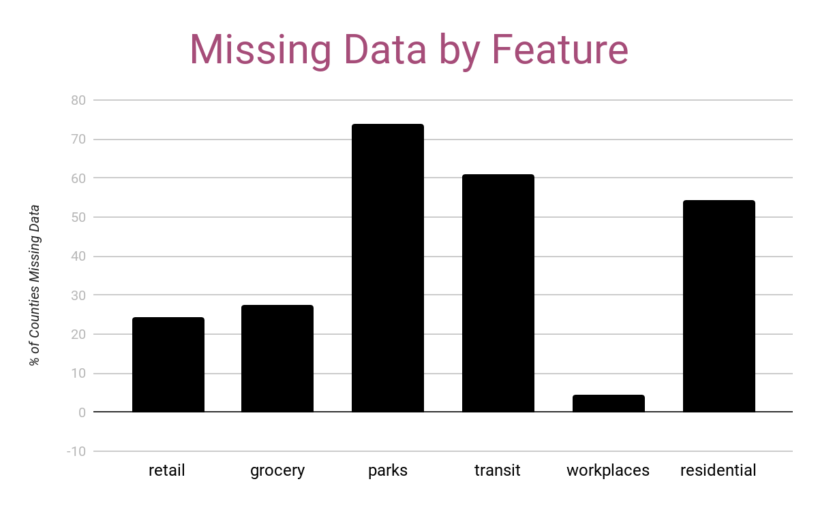
Current Roadblocks and Needs
Missing Data
A lot of the mobility data is missing
Not random, significant amounts are missing for some features
Quantifying Social Distancing
Varying indices exist
Most are relatively simplistic in nature.
Building a more robust one is an entire endeavour on its own and require time.

Slide 10
Feedback from Mentors
Notes:
Behaviour vs ability vs both
Rather than dichotmize by essential vs non-essential
To tackle the missing data issue by identifying whether they fit into one of these category (dichotomy score)
Whether we can impute the missing data using multi imputation strategies (we may not want to impute the outcome)
Compare who is social distancing for work who isnt
Should we combine the colorado index and the unacast index or only use one of them?
Multiple imputation strategy
Can do this if the index is an input to another equation.
Not if the index is the ultimate output
Everything is a behavior
Do you have the choice or not?
Think in theory whether the activity is essential or not
Different racial groups have different occupations.
-Arjumand Siddiqi (Expert Epidemiologist)
Disparities vs Social Determinatants of health
Disparties are when SDOH are misallocated?
Not about culture, not genetic, experiences of daily life based on racial groups
Kind of work you do (Occupation)
County level data on occupational data by race
Symptoms are so general
Syptooms dismissed for black people (especially women)
Inability to acces those minds
Rent vs own (county level) proxies of
BASIC regression
Decomposition regression : asks a slightly different question
- Normal regression: What is the relative cost of not social distancing when it comes to race?
- Decomposition: what variables account for the difference in the distribution (diff is it accounts for the absolute gaps between two distributions/ means)
You get causal variables
Ie. dichotomous variables- social distancing = you do it or dont
70% of whites are able to social distance
30% of blacks are able
Decomposition: absolute gap is 30%; how which of which are accounted for differences in density/ occupations
Absolute estimates add up to 30% (22% by all the known variables, 8% is unknown); residual becomes intuitive
If you give black the characteristics of white, how does their sd change? How much do these variables actually account for the diff?
Dinardo Fortan,Tomas Lemieux
Blider, Wahaka
Decomposing dichotomous outcomes
Blinder–Oaxaca decomposition
FRANK:
Bridgeport: No health director. (such factors)
Mostly black and hispanic
Chicago, New Orleans
Failure of public health
Most of the deaths are in Nursing home.

